Slide 1
Chapter No. 4
Transport Layer Protocols
(18 Marks)

Slide 2
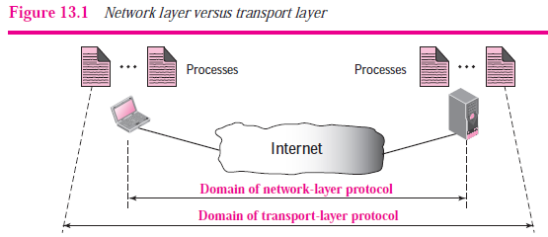
Transport Layer Protocols-Services
Process-to-Process Communication:-The first duty of a transport-layer protocol is to provide process-to-process communication.
A process is an application-layer entity (running program) that uses the
services of the transport layer.
To understand the difference between host-to-host communication and
process-to-process communication.
A transport layer protocol is responsible for delivery of the message to the
appropriate process.

Slide 3
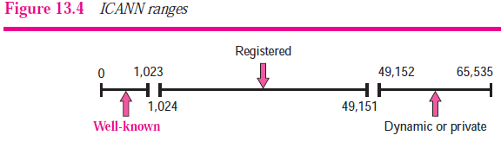
Transport Layer Protocols-Services
2. Addressing: Port Numbers
The local host and the remote host are defined using IP addresses. To define the processes, we need second identifiers called port numbers.
In the TCP/IP protocol suite, the port numbers are integers between 0 and 65,535.
ICANN has divided the port numbers into three ranges: well-known, registered, and dynamic (or private), as shown in Figure 13.4.

Slide 4
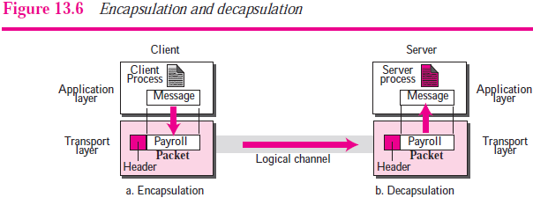
Transport Layer Protocols-Services
3. Encapsulation and Decapsulation

Slide 5
Transport Layer Protocols-Services
3. Encapsulation and Decapsulation
To send a message from one process to another, the transport layer protocol encapsulates and decapsulates messages (Figure 13.6).
Encapsulation happens at the sender site. When a process has a message to send, it passes the message to the transport layer along with a pair of socket addresses and some other pieces of information that depends on the transport layer protocol.
The transport layer receives the data and adds the transport-layer header.
The packets at the transport layers in the Internet are called user datagrams, segments, or packets.
Decapsulation happens at the receiver site. When the message arrives at the destination transport layer, the header is dropped and the transport layer delivers the message to the process running at the application layer.

Slide 6

Transport Layer Protocols-Services
4. Multiplexing and Demultiplexing
Whenever an entity accepts items from more than one
source, it is referred to as multiplexing (many to one).
Whenever an entity delivers items to more than one source, it
is referred to as demultiplexing (one to many).

Slide 7
Transport Layer Protocols-Services
5. Flow Control
Whenever an entity produces items and another entity
consumes them, there should be a balance between
production and consumption rates.
The sending process at the application layer is only a producer.
It produces message chunks and pushes them to the transport
layer.
The sending transport layer has a double role: it is both a
consumer and the producer. It consumes the messages
pushed by the producer.
It encapsulates the messages in packets and pushes them to
the receiving transport layer.
The receiving transport layer has also a double role: it is the
consumer for the packets received from the sender.
It is also a producer; it needs to decapsulates the messages
and deliver them to the application layer.

Slide 8
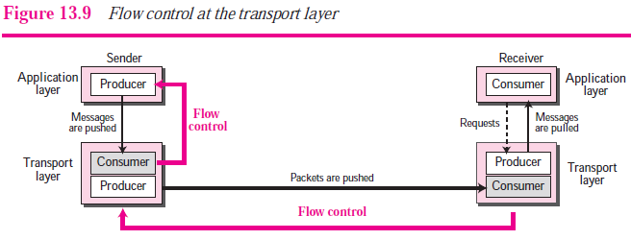
Transport Layer Protocols-Services
5. Flow Control
Figure 13.9 shows that we need at least two cases of flow control: from the sending transport layer to the sending application layer and from the receiving transport layer to
the sending transport layer.

Slide 9
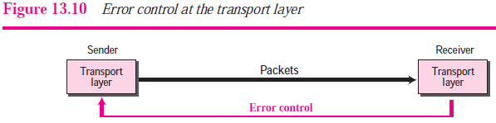
Transport Layer Protocols-Services
6. Error Control
Error control at the transport layer is responsible to
1. Detect and discard corrupted packets.
2. Keep track of lost and discarded packets and resend them.
3. Recognize duplicate packets and discard them.
4. Buffer out-of-order packets until the missing packets arrive.
Figure 13.10 shows the error control between the sending and receiving transport layer. As with the case of flow control, the receiving transport layer manages error control, most of the time, by informing the sending transport layer about the problems.

Slide 10
Transport Layer Protocols-Services
7. Congestion Control
An important issue in the Internet is congestion.
Congestion in a network may occur if the load on the
network—the number of packets sent to the network—is
greater than the capacity of the network—the number of
packets a network can handle.
Congestion control refers to the mechanisms and
techniques to control the congestion and keep the load
below the capacity.

Slide 11
Transport Layer Protocols-Services
8. Connectionless and Connection-Oriented Services
In a connectionless service, the source process (application program) needs to divide its message into chunks of data of the size acceptable by the transport layer and deliver them to the transport layer one by one.
In a connection-oriented service, the client and the server first need to establish a connection between themselves.
The data exchange can only happen after the connection establishment. After data exchange, the connection needs to be teared down.

Slide 12
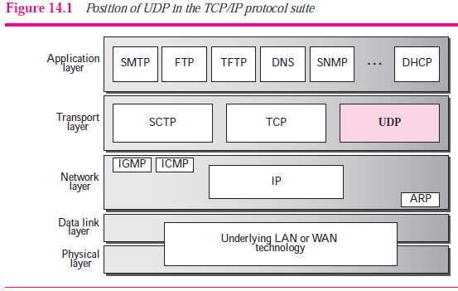
UDP(User Datagram Protocol)
The original TCP/IP protocol suite specifies two protocols for the transport layer: UDP and TCP

Slide 13
Introduction-UDP
Above Figure shows the relationship of the User
Datagram Protocol (UDP) to the other protocols
and layers of the TCP/IP protocol suite.
UDP is located between the application layer and the
IP layer, and serves as the intermediary between the
application programs and the network operations.
UDP is a connectionless, unreliable transport
protocol.
UDP provides a connectionless packet service that
offers unreliable ‘best effort’ delivery. This means that
arrival of packets is not guaranteed, nor is the correct
sequencing of delivered packets.

Slide 14
Responsibilities of UDP
To create a process-to-process communication, UDP
uses port numbers to accomplish this.
To provide control mechanisms at the transport level,
UDP does not provide flow control & acknowledgment
for received packets.
It does not add anything to the services of IP
except for providing process-to-process
communication.

Slide 15
Advantages of UDP
UDP is a very simple protocol using a minimum of
overhead.
If a process wants to send a small message and does
not care much about reliability, it can use UDP.
Sending a small message using UDP takes much less
interaction between the sender and receiver than
using TCP.

Slide 16
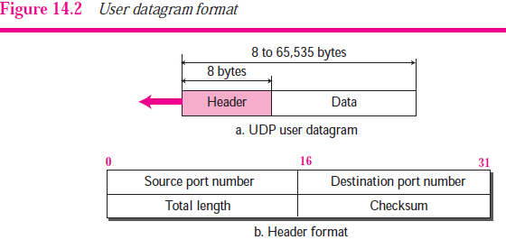
User Datagram:
UDP packets, called user datagram's, have a fixed-
size header of 8 bytes.
Below Figure 14.2 shows the format of a user datagram.

Slide 17
User Datagram:
Source port number.
This is the port number used by the process
running on the source host.
It is 16 bits long, which means that the port number
can range from 0 to 65,535.
If the source host is the client, means if a client
sending a request, using UDP, then generally an
ephemeral (temporary) port number requested
by the process and chosen by the UDP.
If the source host is the server (a server sending a
response), the port number, in most cases, is a well-
known port number.

Slide 18
User Datagram:
Destination port number.
This is the port number used by the process
running on the destination host.
It is also 16 bits long.
If the destination host is the server (a client sending
a request), the port number, in most cases, is a well
known port number is used.
If the destination host is the client (a server sending
a response), the port number, in most cases, is an
ephemeral port number.

Slide 19
User Datagram:
Length
This is a 16-bit field that defines the total length of the
user datagram, header plus data.
The 16 bits can define a total length of 0 to 65,535 bytes.
However, the total length needs to be much less because a
UDP user datagram is stored in an IP datagram with the total
length of 65,535 bytes.
The length field in a UDP user datagram is actually not
necessary, Because UDP datagram is actually encapsulated
in an IP datagram.
There is a field in the IP datagram that defines the total length.
There is another field in the IP datagram that defines the
length of the header.
So if we subtract the value of the second field from the first, we can deduce the length of the UDP datagram that is encapsulated in an IP datagram.
UDP length = IP length − IP header’s length

Slide 20
User Datagram:
Checksum.
This field is used to detect errors over the entire
user datagram (header plus data).
Example 14.1
The following is a dump of a UDP header in hexadecimal format.
CB84000D001C001C
a. What is the source port number?
b. What is the destination port number?
c. What is the total length of the user datagram?
d. What is the length of the data?
e. Is the packet directed from a client to a server or vice versa?
f. What is the client process?

Slide 21
User Datagram:
CB84000D001C001C
Solution:-
a. The source port number is the first four hexadecimal digits (CB84)16
which means that the source port number is 52100.
b. The destination port number is the second four hexadecimal digits (000D)16, which means that the destination port number is 13.
c. The third four hexadecimal digits (001C)16 define the length of the whole UDP packet as 28 bytes.
d. The length of the data is the length of the whole packet minus the length of the header, or 28 – 8 = 20 bytes.
e. Since the destination port number is 13 (well-known port), the packet is from the client to the server.
f. The client process is the Daytime (see Table 14.1).

Slide 22
UDP Services:
Process-to-Process Communication.
Connectionless Services
Flow Control
Error Control
Checksum
Congestion Control
Encapsulation and Decapsulation
Queuing
Multiplexing and Demultiplexing

Slide 23
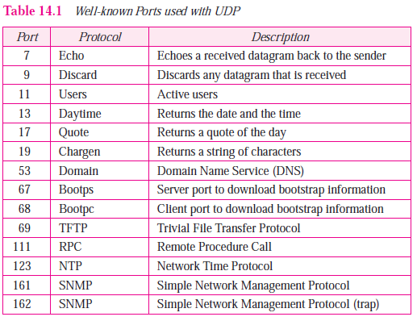
UDP Services:
Process-to-Process Communication.
Well-known Ports
used with UDP

Slide 24
UDP Services:
Connectionless Services
UDP provides a connectionless service.
This means that each user datagram sent by UDP is an
independent datagram. There is no relationship
between the different user datagrams even if they are
coming from the same source process and going to the
same destination program.
There is no connection establishment and no
connection termination as is the case for TCP.
This means that each user datagram can travel on a
different path.

Slide 25
UDP Services:
Flow Control :-
UDP is a very simple protocol. There is no flow control, and hence no window mechanism.
The receiver may overflow with incoming messages. The lack of flow control means that the process using UDP should provide for this service, if needed.
Error Control
There is no error control mechanism in UDP except for the checksum.
This means that the sender does not know if a message has been lost or duplicated.
When the receiver detects an error through the checksum, the user datagram is silently discarded.
The lack of error control means that the process using UDP should provide for this service if needed.

Slide 26
UDP Services:
Checksum:
The error detection method used by most TCP/IP protocols
is called the checksum.
The checksum protects against the corruption that may
occur during the transmission of a packet. It is redundant
information added to the packet.
The checksum is calculated at the sender and the value
obtained is sent with the packet. The receiver repeats the
same calculation on the whole packet including the
checksum.

Slide 27
UDP Services:
Checksum Calculation at the Sender
At the sender, the packet header is divided into n-bit sections (n is usually 16).
These sections are added together using one’s complement arithmetic resulting in a sum that is also n bits long.
The sum is then complemented (all 0s changed to 1s and all 1s to 0s) to produce the checksum.

Slide 28
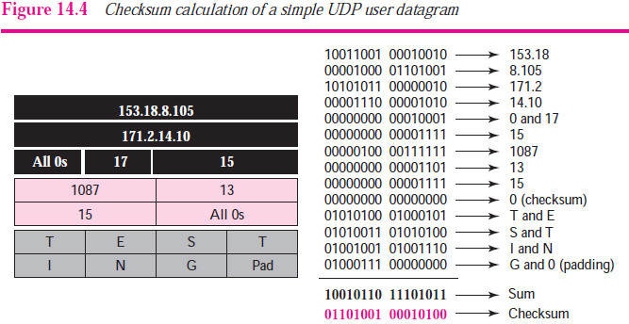
UDP Services:

Slide 29
UDP Services:
Congestion Control
Since UDP is a connectionless protocol, it does not provide congestion control.
UDP assumes that the packets sent are small and sporadic, and cannot create congestion in
the network.
This assumption may or may not be true today when UDP is used for real time transfer of audio and video.
Encapsulation and Decapsulation
To send a message from one process to another, the UDP protocol encapsulates and decapsulates messages.

Slide 30
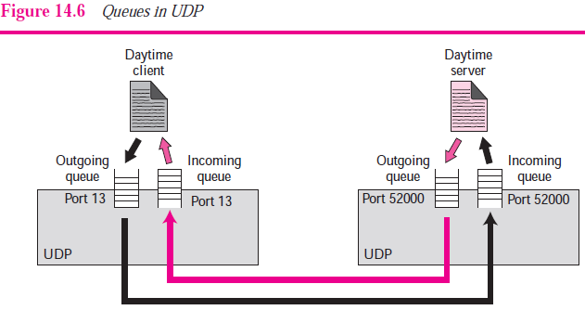
UDP Services:
Queuing:

Slide 31
UDP Services:
Queuing:
At the client site, when a process starts, it requests a
port number from the operating system.
Some implementations create both an incoming and
an outgoing queue associated with each process.
Other implementations create only an incoming queue
associated with each process.
Note that even if a process wants to communicate with multiple
processes, it obtains only one port number and eventually one
outgoing and one incoming queue.
The queues opened by the client are, in most cases, identified
by ephemeral port numbers.
The queues function as long as the process is running. When
the process terminates, the queues are destroyed.

Slide 32
UDP Services:
Queuing:
The client process can send messages to the outgoing
queue by using the source port number specified in
the request.
UDP removes the messages one by one, and, after
adding the UDP header, delivers them to IP.
An outgoing queue can overflow. If this happens, the
operating system can ask the client process to wait
before sending any more messages.
At the server site, the mechanism of creating queues is different. In its simplest form, a server asks for incoming and outgoing queues using its well-known port when
it starts running. The queues remain open as long as the server is running.

Slide 33
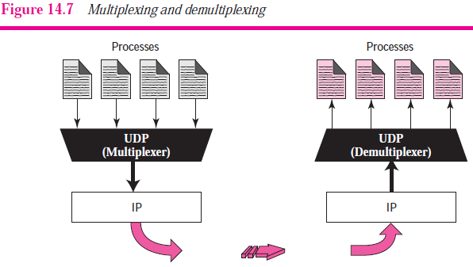
UDP Services:
Multiplexing and Demultiplexing

Slide 34
UDP Services:
Multiplexing and Demultiplexing
Multiplexing
At the sender site, there may be several processes that need to send user datagrams.
However, there is only one UDP. This is a many-to-one relationship and requires multiplexing.
UDP accepts messages from different processes, differentiated by their
assigned port numbers. After adding the header, UDP passes the user datagram to IP.
Demultiplexing
At the receiver site, there is only one UDP.
However, we may have many processes that can receive user datagrams.
This is a one-to-many relationship and requires demultiplexing.
UDP receives user datagrams from IP. After error checking and dropping of
the header, UDP delivers each message to the appropriate process based on the port numbers.

Slide 35
UDP Applications
The following shows some typical applications that can benefit more from the services of UDP than from those of TCP.
❑ UDP is suitable for a process that requires simple request-response communication with little concern for flow and error control.
❑ UDP is suitable for a process with internal flow and error-control mechanisms.
❑ UDP is a suitable transport protocol for multicasting. Multicasting capability is embedded in the UDP software but not in the TCP software.
❑ UDP is used for management processes such as SNMP.
❑ UDP is used for some route updating protocols such as Routing Information Protocol (RIP)
❑ UDP is normally used for real-time applications that cannot tolerate uneven delay between sections of a received message.

Slide 36
Transmission Control Protocol
(TCP)
TCP is a reliable connection oriented protocol.
i.e. a connection is established between the sender &
receiver before the data can be transmitted.
TCP divides the data it receives from the upper layer
into segments & tags a sequence number to each
segment which is used at the receiving end for
reordering of data.
TCP serves as the intermediary between application
programs(application layer) & the network
operations.(Network layer)

Slide 37
TCP Services
Process-to-Process Communication
Stream Delivery Service
Full-Duplex Communication
Multiplexing and Demultiplexing
Connection-Oriented Service
Reliable Service

Slide 38
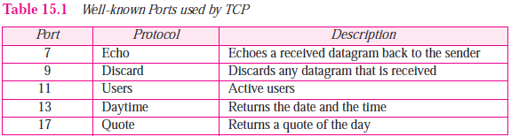
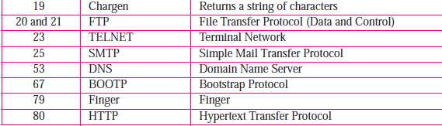
TCP Services
Process-to-Process Communication
TCP provides process-to-process communication i.e. the
transfer of data takes place between individual processes
executing on end systems. This is done using port numbers.
Lists some well-known port numbers used by TCP.

Slide 39
TCP Services
Stream Delivery Service
TCP, unlike UDP, is a stream-oriented protocol. In UDP, a process sends messages with predefined boundaries to UDP for delivery.
UDP adds its own header to each of these messages and delivers it to IP for transmission. Each message from the process is called a user datagram, and becomes, eventually, one IP datagram.

Slide 40
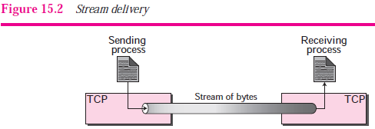
TCP Services
Stream Delivery Service
TCP, on the other hand, allows the sending process to deliver data as a stream of bytes and allows the receiving process to obtain data as a stream of bytes.
TCP creates an environment in which the two processes seem to be connected by an imaginary “tube” that carries their bytes across the Internet.

Slide 41
TCP Services
Full-Duplex Communication
TCP offers full-duplex service, where data can flow in both directions at the same time.
Multiplexing and Demultiplexing
Like UDP, TCP performs multiplexing at the sender and demultiplexing at the receiver.
However, since TCP is a connection-oriented protocol, a connection needs to be established for each pair of processes.

Slide 42
TCP Services
Connection-Oriented Service
When a process at site A wants to send to and receive data from another process at site B, the following three phases occur:
1. The two TCPs establish a virtual connection between them.
2. Data are exchanged in both directions.
3. The connection is terminated.
Reliable Service
TCP is a reliable transport protocol. It uses an acknowledgment mechanism to check the safe and sound arrival of data.

Slide 43
TCP Features
1. Numbering System
The TCP software keeps track of the segments being transmitted or received, there are two fields called the sequence number and the acknowledgment number.
1. Byte Number assigned to data bytes to be transferred: Byte number used for flow control & error control. The bytes of data being transferred in each connection are numbered by TCP. The numbering starts with an arbitrarily generated number.
2. Sequence number to segments:
After the bytes have been numbered, TCP assigns a sequence number to each segment that is being sent.
The sequence number for each segment is the number of the first byte of data carried in that segment.

Slide 44
TCP Features
Numbering System
3. Acknowledgment Number to received segments:
The acknowledgment number is cumulative. Confirmation of received data bytes.
2. Flow Control
TCP provides flow control. The sending TCP controls how much data can accepted from the sending process; the receiving TCP controls how much data can to be sent by the sending TCP.
3. Error Control
To provide reliable service, TCP implements an error control mechanism.
4. Congestion Control
TCP, takes into account congestion in the network. The amount of data sent by a sender is not only controlled by the receiver (flow control), but is also determined by the level of congestion, if any, in the network.

Slide 45
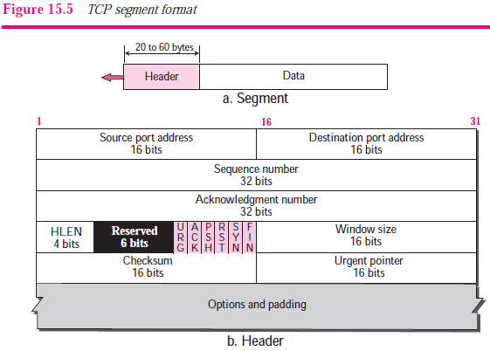
TCP Segment Structure
The packet in TCP is called a segment. TCP segment consists of data bytes to be sent & a header that is added to the data by TCP as shown fig.

Slide 46
TCP Segment Structure
The segment consists of a header of 20 to 60 bytes, followed by data from the application program.
Source port address.
This is a 16-bit field that defines the port number of the
application program in the host that is sending the segment.
Destination port address.
This is a 16-bit field that defines the port number of the
application program in the host that is receiving the segment.
Sequence number.
This 32-bit field defines the number assigned to the first byte of data contained in this segment. As we said before, TCP is a stream transport protocol. To ensure connectivity, each byte to be transmitted is numbered. The sequence number tells the destination which byte in this sequence is the first byte
in the segment.

Slide 47
TCP Segment Structure
Acknowledgment number.
This 32-bit field defines the byte number that the receiver of the segment is expecting to receive from the other party. If the receiver of the segment has successfully received byte number x from the other party, it returns x + 1 as the acknowledgment number. Acknowledgment and data can be
piggybacked together.
Header length.
This 4-bit field indicates the number of 4-byte words in the TCP header. The length of the header can be between 20 and 60 bytes. Therefore, the value of this field is always between 5 (5× 4 = 20) and 15 (15 × 4 = 60).
Reserved.
This is a 6-bit field reserved for future use.

Slide 48
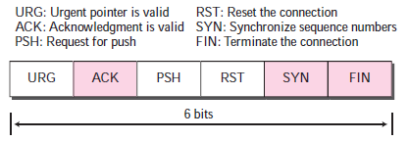
TCP Segment Structure
Control.
This field defines 6 different control bits or flags as shown in Figure 15.6.
One or more of these bits can be set at a time. These bits enable flow control, connection establishment and termination, connection abortion, and the mode of data transfer in TCP.
Window size.
This field defines the window size of the sending TCP in bytes. Note that the length of this field is 16 bits, which means that the maximum size of the window is 65,535 bytes.

Slide 49
TCP Segment Structure
Checksum.
This 16-bit field contains the checksum. The calculation of the checksum for TCP follows the same procedure as the one described for UDP.
However, the use of the checksum in the UDP datagram is optional, whereas the use of the checksum for TCP is mandatory.
Urgent pointer.
This 16-bit field, which is valid only if the urgent flag is set, is used when the segment contains urgent data.
Options.
There can be up to 40 bytes of optional information in the TCP header.

Slide 50
TCP Connection
TCP is connection-oriented.
A connection-oriented transport protocol establishes a virtual path between the source and destination.
All of the segments belonging to a message are then sent over this virtual path. Using a single virtual pathway for the entire message facilitates the acknowledgment process as well as retransmission of damaged or lost frames.
The point is that a TCP connection is virtual, not physical.
In TCP, connection-oriented transmission requires three phases: connection establishment, data transfer, and connection termination.

Slide 51
TCP Connection
Connection establishment
TCP transmits data in full-duplex mode.
When two TCPs in two machines are connected, they are able to send segments to each other simultaneously.
  Three-way handshaking.
The connection establishment in TCP is called three-way handshaking.
In our example, an application program, called the client, wants to make a connection with another application program, called the server, using TCP as the transport layer protocol.

Slide 52
TCP Connection
The process starts with the server. The server program tells its TCP that it is ready to accept a connection. This request is called a passive open. Although the server TCP
is ready to accept a connection from any machine in the world, it cannot make the connection itself.
The client program issues a request for an active open. A client that wishes to connect to an open server tells its TCP to connect to a particular server.
TCP can now start the three-way handshaking process as shown in Figure 15.9.

Slide 53
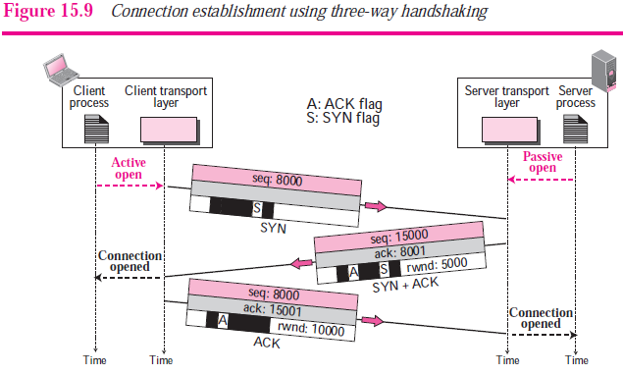
TCP Connection

Slide 54
TCP Connection
The three steps in this phase are as follows.
The client sends the first segment, a SYN segment, in which only the SYN flag is set.
This segment is for synchronization of sequence numbers.
The client in our example chooses a random number as the first sequence number and sends this number to the server.
This sequence number is called the initial sequence
number (ISN).
A SYN segment cannot carry data, but it consumes one sequence number.
2. The server sends the second segment, a SYN + ACK segment with two flag bits set: SYN and ACK.
This segment has a dual purpose. First, it is a SYN segment for communication in the other direction.

Slide 55
TCP Connection
The server uses this segment to initialize a sequence number for numbering the bytes sent from the server to the client.
The server also acknowledges the receipt of the SYN segment from the client by setting the ACK flag and displaying the next sequence number it expects to receive from the client.
A SYN + ACK segment cannot carry data, but does consume one sequence number.
3. ACK Segment:
The client sends the third segment. This is just an ACK segment.
It acknowledges the receipt of the second segment with the ACK flag and acknowledgment number field.
An ACK segment, if carrying no data, consumes no sequence number.

Slide 56
TCP Connection
Data Transfer in TCP
After connection is established, bidirectional data transfer can take place.
The client and server can send data and acknowledgments in both directions.
The acknowledgment is piggybacked with the data.
Figure 15.10 shows an example.
In this example, after a connection is established, the client sends 2,000 bytes of data in two segments. The server then sends 2,000 bytes in one segment. The client sends one more segment.
The first three segments carry both data and acknowledgment,
but the last segment carries only an acknowledgment because there is no more data to be sent.

Slide 57
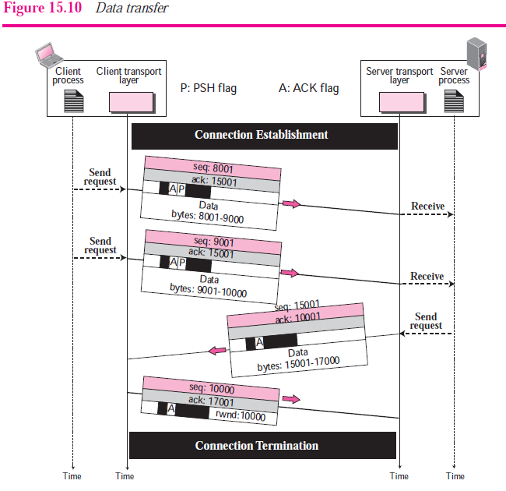
TCP Connection

Slide 58
TCP Connection
Connection Termination
Any of the two parties involved in exchanging data (client or server) can close the connection, although it is usually initiated by the client.
Most implementations today allow two options for connection termination: three-way handshaking and four-way handshaking
with a half-close option.

Slide 59
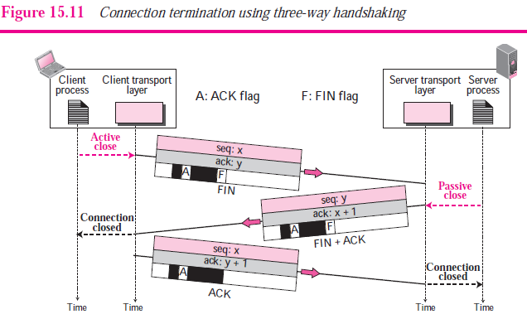
TCP Connection

Slide 60
TCP Connection
In a common situation, the client TCP, after receiving a close command from the client process, sends the first segment, a FIN segment in which the FIN flag is set.
The FIN segment consumes one sequence number if it does not carry data.
2. The server TCP, after receiving the FIN segment, informs its process of the situation and sends the second segment, a FIN+ACK segment, to confirm the receipt of the
FIN segment from the client and at the same time to announce the closing of the connection in the other direction.
3. The client TCP sends the last segment, an ACK segment, to confirm the receipt of the FIN segment from the TCP server. This segment contains the acknowledgment
number, which is one plus the sequence number received in the FIN segment from the server.

Slide 61
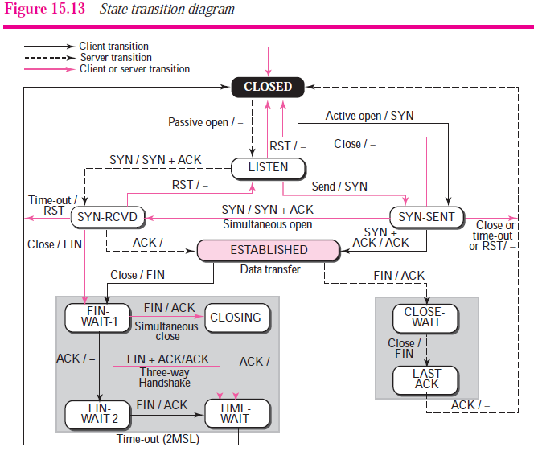
STATE TRANSITION DIAGRAM

Slide 62
STATE TRANSITION DIAGRAM
The figure shows the two FSMs used by the TCP client and server combined in one diagram.
The ovals represent the states. The transition from one state to another is shown using directed lines.
Each line has two strings separated by a slash. The first string is the
input, what TCP receives. The second is the output, what TCP
sends.
The dotted black lines in the figure represent the transition that a server normally goes through; the solid black lines show the transitions that a client normally goes through.
However, in some situations, a server transitions through a solid line or a client transitions through a dotted line.
The colored lines show special situations. in fact two sets of states, a set for the client and another for the server, that are used for flow and error control.

Slide 63
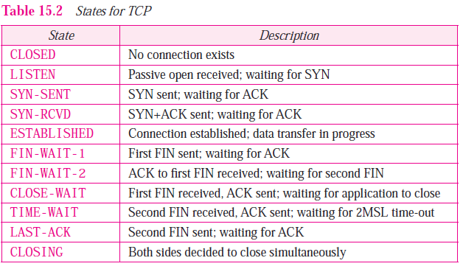
STATE TRANSITION DIAGRAM

Slide 64
WINDOWS IN TCP
TCP uses two windows (send window and receive window) for each direction of data transfer, which means four windows for a bidirectional communication.
Send Window
Figure 15.22 shows an example of a send window.
The window we have used is of size 100 bytes (normally thousands of bytes), but later we see that the send window size is dictated by the receiver (flow control) and the congestion in the underlying network (congestion control). The figure shows how a send window opens, closes, or shrinks.

Slide 65
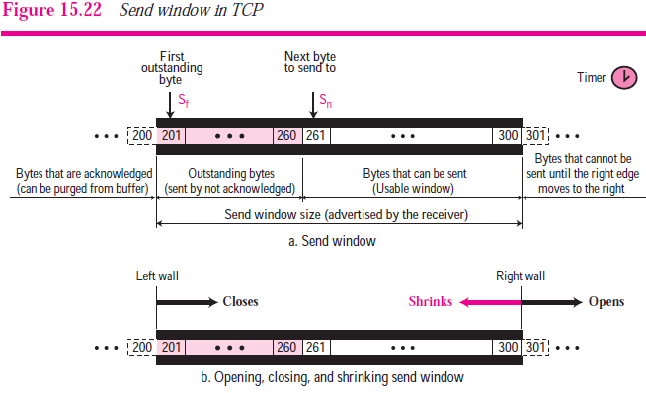
WINDOWS IN TCP
Send Window

Slide 66
WINDOWS IN TCP
Receive Window
Figure 15.23 shows an example of a receive window. The window we have used is of size 100 bytes (normally thousands of bytes).
The figure also shows how the receive window opens and closes; in practice, the window should never shrink.

Slide 67
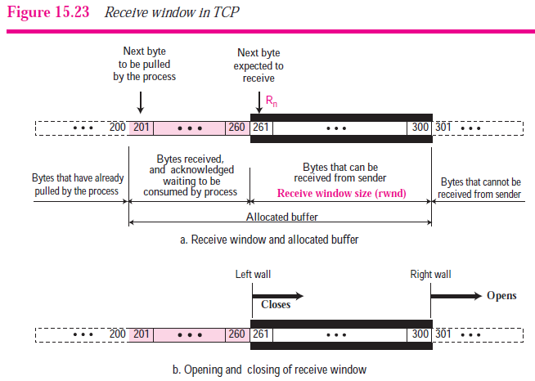
WINDOWS IN TCP
Receive Window

Slide 68
WINDOWS IN TCP
Receive Window

Slide 69
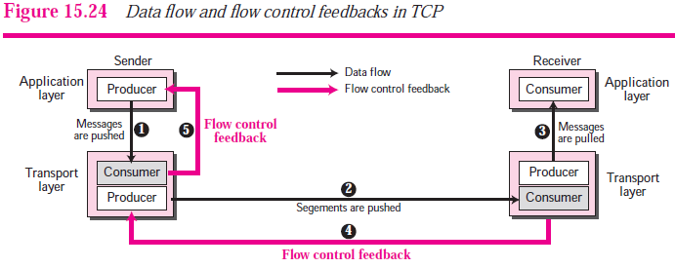
Flow Control
flow control balances the rate a producer creates data with the rate a consumer can use the data.

Slide 70
Flow Control
The figure shows that data travel from the sending process down to the sending TCP, from the sending TCP to the receiving TCP, and from receiving TCP up to the receiving process (paths 1, 2, and 3).
Flow control feedbacks, however, are traveling from the receiving TCP to the sending TCP and from the sending TCP up to the sending process (paths 4 and 5).
The receiving TCP controls the sending TCP; the sending TCP controls the sending process.
Flow control feedback from the sending TCP to the sending process (path 5) is achieved through simple rejection of data by sending TCP when its window is full.

Slide 71
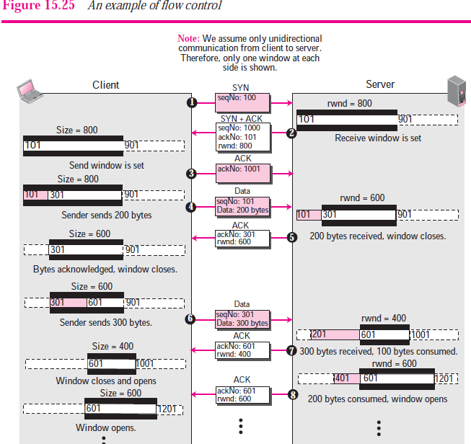
Example of Flow Control

Slide 72
Error Control
TCP is a reliable transport layer protocol. This means that an application program that delivers a stream of data to TCP relies on TCP to deliver the entire stream to the application program on the other end in order, without error, and without any part lost or duplicated.
TCP provides reliability using error control. Error control includes mechanisms for detecting and resending corrupted segments, resending lost segments, storing out-of order segments until missing segments arrive, and detecting and discarding duplicated segments.
Error control in TCP is achieved through the use of three simple tools: checksum, acknowledgment, and time-out.

Slide 73
Error Control
Checksum
Each segment includes a checksum field, which is used to check for a corrupted segment.
If a segment is corrupted as deleted by an invalid checksum, the segment is discarded by the destination TCP and is considered as lost.
Acknowledgment
TCP uses acknowledgments to confirm the receipt of data segments.
Control segments that carry no data, but consume a sequence number, are also acknowledged. (the segment with the smallest sequence number) and restarts the timer.

Slide 74
Error Control
Retransmission after RTO (Time Out)
The sending TCP maintains one retransmission time-out (RTO) for each connection.
When the timer matures, i.e. times out, TCP sends the segment in the front of the queue (the segment with the smallest sequence number) and restarts the timer.

Slide 75
Error Control
Error control at the transport layer is responsible to
1. Detect and discard corrupted packets.
2. Keep track of lost and discarded packets and resend them.
3. Recognize duplicate packets and discard them.
4. Buffer out-of-order packets until the missing packets arrive.
Figure 13.10 shows the error control between the sending and receiving transport layer. As with the case of flow control, the receiving transport layer manages error control, most of the time, by informing the sending transport layer about the problems.

Slide 76
Congestion Control
An important issue in the Internet is congestion.
Congestion in a network may occur if the load on the
network—the number of packets sent to the network—is
greater than the capacity of the network—the number of
packets a network can handle.
Congestion control refers to the mechanisms and
techniques to control the congestion and keep the load
below the capacity.
Congestion Policy
TCP’s general policy for handling congestion is based on three phases: slow start, congestion avoidance, and congestion detection.

Slide 77
Congestion Control
Slow Start: Exponential Increase
In the slow start phase, the sender starts with a slow rate of
transmission, but increases the rate rapidly to reach a
threshold.
The slow start algorithm is based on the idea that the size
of the congestion window (cwnd) starts with one maximum
segment size (MSS).
The MSS is determined during connection establishment using
an option of the same name. The size of the window increases
one MSS each time one acknowledgement arrives.
As the name implies, the algorithm starts slowly, but grows
exponentially.

Slide 78
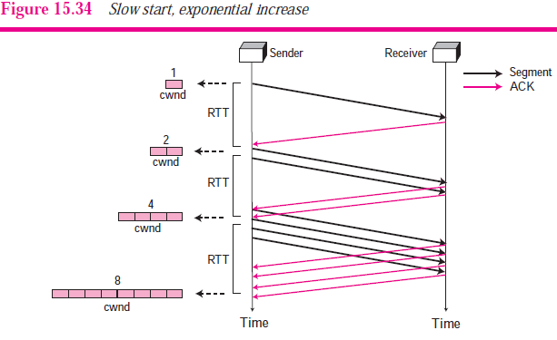
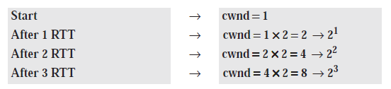
Congestion Control
If we look at the size of the cwnd in terms of round-trip times (RTTs), we find that the growth rate is exponential as shown below:

Slide 79
Congestion Control
Congestion Avoidance: Additive Increase
If we start with the slow start algorithm, the size of the
congestion window increases exponentially.
To avoid congestion before it happens, one must slow down
this exponential growth.
TCP defines another algorithm called congestion avoidance,
which increases the cwnd additively instead of exponentially.

Slide 80
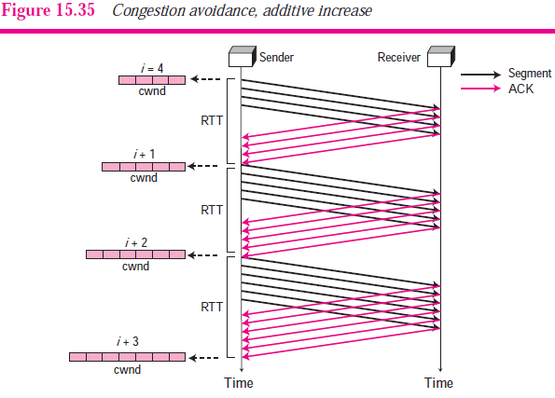
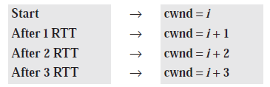
Congestion Control
In the congestion avoidance algorithm the size of the congestion window increases additively until congestion is detected.

Slide 81
Congestion Control
Congestion Detection: Multiplicative Decrease
If congestion occurs, the congestion window size must be decreased.
The only way a sender can guess that congestion has occurred is the need to retransmit a segment.
This is a major assumption made by TCP.
Retransmission is needed to recover a missing packet which
is assumed to have been dropped (i.e., lost) by a router that
had so many incoming packets, that had to drop the missing
segment, i.e., the router/network became overloaded or
congested.
In this cases, the size of the threshold is dropped to half
(multiplicative decrease).

Slide 82
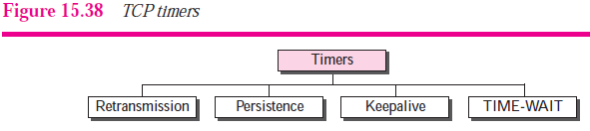
TCP TIMERS
To perform its operation smoothly, most TCP implementations use at least four timers as shown in Figure 15.38.

Slide 83
TCP TIMERS
1. Retransmission Timer
To retransmit lost segments, TCP employs one retransmission
timer that handles the retransmission time-out (RTO), the
waiting time for an acknowledgment of a segment.
We can define the following rules for the retransmission timer:
1. When TCP sends the segment in front of the sending queue, it starts the timer.
2. When the timer expires, TCP resends the first segment in front of the queue, and restarts the timer.
3. When a segment (or segments) are cumulatively acknowledged, the segment (or segments) are purged from the queue.
4. If the queue is empty, TCP stops the timer; otherwise, TCP restarts the timer.

Slide 84
TCP TIMERS
2. Persistence Timer
To deal with a zero-window-size advertisement, TCP needs
another timer.
If the receiving TCP announces a window size of zero, that
means deadlock situation.
To correct this deadlock, TCP uses a persistence timer for
each connection.
TCP receives an acknowledgment with a window size of zero,
it starts a persistence timer.

Slide 85
TCP TIMERS
3. Keepalive Timer
A keepalive timer is used in some implementations to
prevent a long idle connection between two TCPs.
Suppose that a client opens a TCP connection to a server,
transfers some data, and becomes silent. Perhaps the client
has crashed.
In this case, the connection remains open forever.
4. TIME-WAIT Timer
The TIME-WAIT (2MSL) timer is used during connection
termination.
The timer starts after sending the last ACK for 2nd FIN &
closing the connection.

Slide 86
TCP TIMERS
3. Keepalive Timer
A keepalive timer is used in some implementations to
prevent a long idle connection between two TCPs.
Suppose that a client opens a TCP connection to a server,
transfers some data, and becomes silent. Perhaps the client
has crashed.
In this case, the connection remains open forever.
4. TIME-WAIT Timer
The TIME-WAIT (2MSL) timer is used during connection
termination.
The timer starts after sending the last ACK for 2nd FIN &
closing the connection.

Slide 87
Stream Control Transmission Protocol (SCTP)
We describe the new transport-layer protocol called SCTP.
SCTP is designed as a general-purpose transport layer
protocol that can handle multimedia and stream traffic, which
are increasing every day on the Internet.
SCTP lies between the application layer and the network layer
and serves as the intermediary between the application
programs and the network operations.
These new applications, such as IUA (ISDN over IP), M2UA
and M3UA (telephony signaling), H.248 (media gateway
control), H.323 (IP telephony), and SIP (IP telephony), need a
more sophisticated service than TCP can provide.
SCTP provides this enhanced performance and reliability.

Slide 88
Stream Control Transmission Protocol (SCTP)
UDP is a message-oriented protocol. A process delivers a
message to UDP, which is encapsulated in a user datagram
and sent over the network.
TCP is a byte-oriented protocol. It receives a message or
messages from a process, stores them as a stream of
bytes, and sends them in segments.
SCTP combines the best features of UDP and TCP.
SCTP is a reliable message oriented protocol.
It preserves the message boundaries and at the same time detects lost data, duplicate data, and out-of-order data.
It also has congestion control and flow control mechanisms.

Slide 89
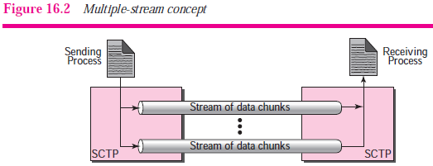
SCTP SERVICES
1. Process-to-Process Communication:- SCTP uses all well-known ports in the TCP space.
2. Multiple Streams:-SCTP allows multistream service in
each connection, which is called association in SCTP terminology.
If one of the streams is blocked, the other streams can still deliver their data.
An association in SCTP can involve multiple streams.

Slide 90
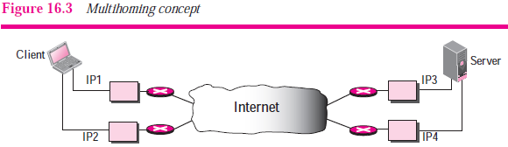
SCTP SERVICES
3. Multihoming :-
SCTP association allows multiple IP addresses for each end.
In the figure, the client is connected to two local networks with two IP addresses. The server is also connected to two networks with two IP addresses.
The client and the server can make an association using four different pairs of IP addresses.
However, note that in the current implementations of SCTP, only one pair of IP addresses can be chosen for normal communication; the alternative is used if the main choice fails.
In other words, at present, SCTP does not allow load sharing between different paths.

Slide 91
SCTP SERVICES
4. Full-Duplex Communication
Like TCP, SCTP offers full-duplex service, where data can flow in both directions at the same time.
5. Connection-Oriented Service
Like TCP, SCTP is a connection-oriented protocol. However, in SCTP, a connection is called an association.
When a process at site A wants to send and receive data from another process at site B, the following occurs:
1. The two SCTPs establish an association between each other.
2. Data are exchanged in both directions.
3. The association is terminated.
6. Reliable Service
SCTP, like TCP, is a reliable transport protocol. It uses an acknowledgment mechanism to check the safe and sound arrival of data.

Slide 92
SCTP FEATURES
Transmission Sequence Number (TSN)
The unit of data in TCP is a byte. Data transfer in TCP is controlled by numbering bytes using a sequence number.
Data transfer in SCTP is controlled by numbering the data chunks. SCTP uses a transmission sequence number
(TSN) to number the data chunks.
2. Stream Identifier (SI)
In SCTP, there may be several streams in each association.
Each stream in SCTP needs to be identified using a stream
identifier(SI).
Each data chunk must carry the SI in its header so that when it arrives at the destination, it can be properly placed in its stream.
The SI is a 16-bit number starting from 0.

Slide 93
SCTP FEATURES
3. Stream Sequence Number (SSN)
SCTP defines each data chunk in each stream with a stream sequence number (SSN).
4. Packets
In TCP, a segment carries data and control information. Data are carried as a collection of bytes.
The design of SCTP is totally different: data are carried as data chunks, control information as control chunks.
Several control chunks and data chunks can be packed together in a packet.
A packet in SCTP plays the same role as a segment in TCP.
5. Acknowledgment Number
In SCTP, acknowledgment numbers are used to acknowledge only data chunks; control chunks are acknowledged by other control chunks if necessary.

Slide 94
SCTP FEATURES
6. Flow Control
Like TCP, SCTP implements flow control to avoid overwhelming the receiver.
7. Error Control
Like TCP, SCTP implements error control to provide reliability.
8. Congestion Control
Like TCP, SCTP implements congestion control to determine how many data chunks can be injected into the network.

Slide 95
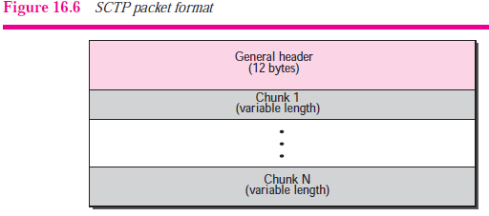
PACKET FORMAT
An SCTP packet has a mandatory general header and a set of blocks called chunks.
There are two types of chunks: control chunks and data chunks.
A control chunk controls and maintains the association; a data chunk carries user data.
In a packet, the control chunks come before the data chunks.
Figure 16.6 shows the general format of an SCTP packet.

Slide 96
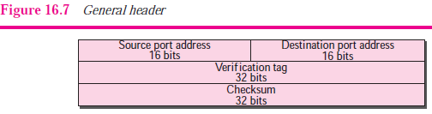
PACKET FORMAT
General Header
The general header (packet header) defines the end points of each association to which the packet belongs, guarantees that the packet belongs to a particular association, and
preserves the integrity of the contents of the packet including the header itself. The format of the general header is shown in Figure 16.7..

Slide 97
PACKET FORMAT
Source port address:- This is a 16-bit field that defines the port number of the process sending the packet.
Destination port address. This is a 16-bit field that defines the port number of the process receiving the packet.
Verification tag. This is a number that matches a packet to an association.
Checksum. This 32-bit field contains a CRC-32 checksum.
Note that the size of the checksum is increased from 16 bits (in UDP, TCP, and IP) to 32 bits in SCTP to allow the use of the CRC-32 checksum.

Slide 98
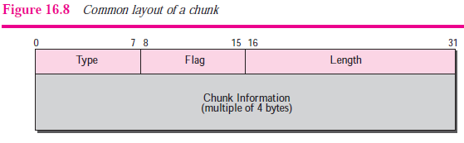
PACKET FORMAT
Chunks
Control information or user data are carried in chunks
❑ Type. This 8-bit field can define up to 256 types of chunks. Only a few have been defined so far; the rest are reserved for future use.
❑ Flag. This 8-bit field defines special flags that a particular chunk may need.
❑ Length. This 16-bit field defines the total size of the chunk, in bytes, including the type, flag, and length fields.

Slide 99
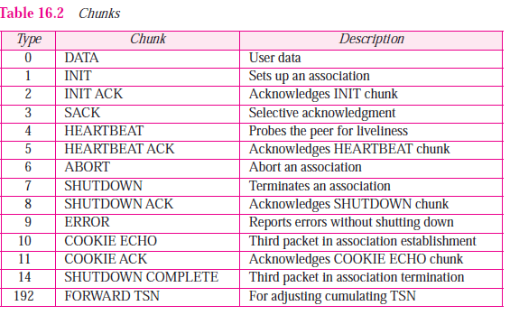

Slide 100
SCTP ASSOCIATION
1. Association Establishment
Association establishment in SCTP requires a four-way handshake.
In this procedure, a process, normally a client, wants to establish an association with another process, normally a server, using SCTP as the transport layer protocol.
Similar to TCP, the SCTP server needs to be prepared to receive any association (passive open).
Association establishment, however, is initiated by the client (active open).
SCTP association establishment is shown in Figure 16.19.

Slide 101
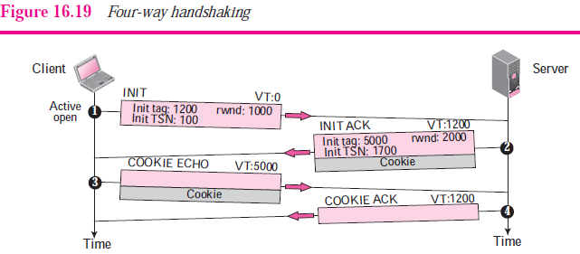
SCTP ASSOCIATION

Slide 102
SCTP ASSOCIATION
The client sends the first packet, which contains an INIT chunk.
The verification tag (VT) of this packet (defined in the general header) is 0 because no verification tag has yet been defined for this direction (client to server).
2. The server sends the second packet, which contains an INI ACK chunk.
The verification tag is the value of the initial tag field in the INIT chunk.
This chunk initiates the tag to be used in the other direction, defines the initial TSN, for data flow from server to client, and sets the servers’ rwnd.
The INIT ACK also sends a cookie that defines the state of the server at this moment.

Slide 103
SCTP ASSOCIATION
3. The client sends the third packet, which includes a COOKIE ECHO chunk.
This is a very simple chunk that echoes, without change, the cookie sent by the server.
4. The server sends the fourth packet, which includes the COOKIE ACK chunk that acknowledges the receipt of the COOKIE ECHO chunk.

Slide 104
SCTP ASSOCIATION
2. Data Transfer
The whole purpose of an association is to transfer data between two ends.
After the association is established, bidirectional data transfer can take place.
The client and the server can both send data.

Slide 105
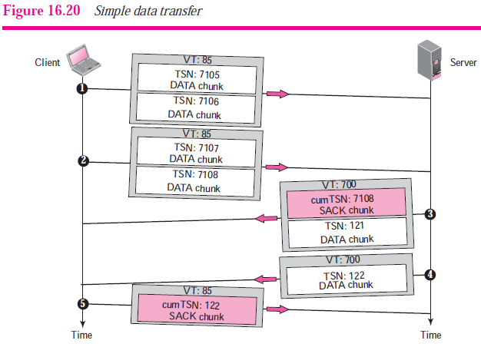
SCTP ASSOCIATION

Slide 106
SCTP ASSOCIATION
1. The client sends the first packet carrying two DATA chunks with TSNs 7105 and 7106.
2. The client sends the second packet carrying two DATA chunks with TSNs 7107 and 7108.
3. The third packet is from the server. It contains the SACK chunk needed to acknowledge the receipt of DATA chunks from the client. The third packet also includes the first DATA chunk from the server with TSN 121.
4. After a while, the server sends another packet carrying the last DATA chunk with TSN 122, but it does not include a SACK chunk in the packet because the last DATA chunk received from the client was already acknowledged.
5. Finally, the client sends a packet that contains a SACK chunk acknowledging the receipt of the last two DATA chunks from the server.

Slide 107
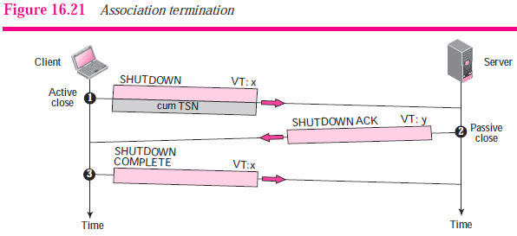
SCTP ASSOCIATION
3. Association Termination
In SCTP, like TCP, either of the two parties involved in exchanging data (client or server) can close the connection.

Slide 108
FLOW CONTROL
Flow control in SCTP is similar to that in TCP. In TCP, we need to deal with only one unit of data, the byte.
In SCTP, we need to handle two units of data, the byte and the chunk.
ERROR CONTROL
SCTP, like TCP, is a reliable transport-layer protocol. It uses a SACK chunk to report the state of the receiver buffer to the sender.

Slide 109
End of Chapter

